Slide 1

Game Design Goal Oriented Approach for Procedural Content Generation
National Taiwan University of Science and Technology
Department of Computer Science and Information Engineering
Ze-Hao Wang
Master Thesis Oral Defense
July 27, 2017
Prof. Wen-Kai Tai
Committee Chairperson
Prof. Hsing-Kuo Pao
Committee Member
Prof. Tung-Ju Hsieh
Committee Member
Prof. Wen-Huang Cheng
Committee Member

Slide 2
Agenda
Introduction
Related Works
Mission / Space framework
Map Sketches & Evolution of Segments
Proposed Methodologies
System Framework
Mission Grammars
Room Definitions and Instruction
Genetic Algorithm in Segments Evolution
Experimental Results
Conclusions and Contributions
Future work

Slide 3
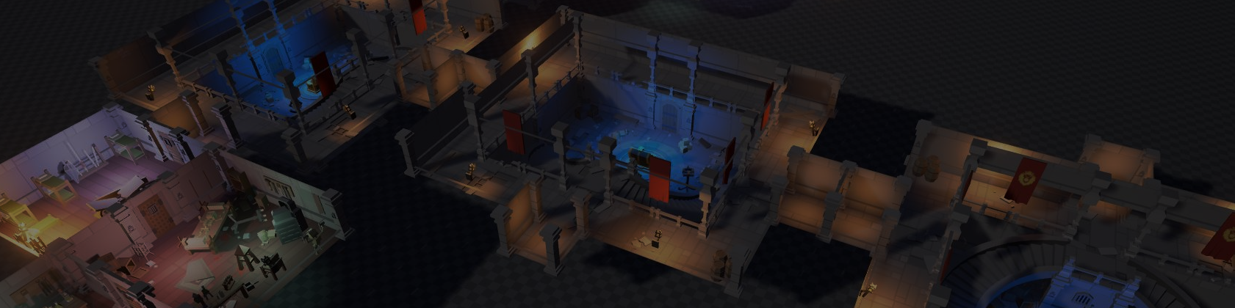
Introduction
Motivation
Research Goals

Slide 4

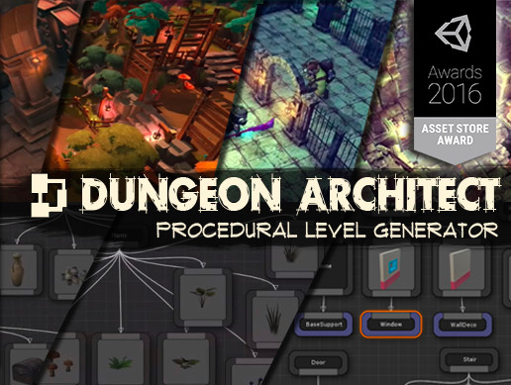
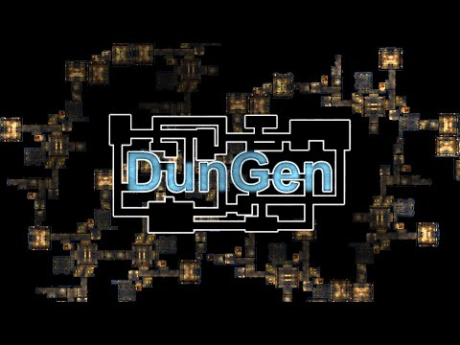
Motivation
程序化內容自動生成 (Procedural Content Generation) 在過去就廣泛被應用於遊戲設計領域，其主要目的為增加遊戲內容的隨機性與多樣性。
我們預期讓玩家在進行遊戲時能夠遵循關卡設計師的劇情脈絡外，亦能夠體驗到有意義且多樣化的遊戲關卡內容。
 | Dungeon Architect | DunGen
Build topology | Randomly PCG, Manually | Randomly PCG
Mission-based topology | None | Stable-linear structure
Dungeon Architect
DunGen

Slide 5
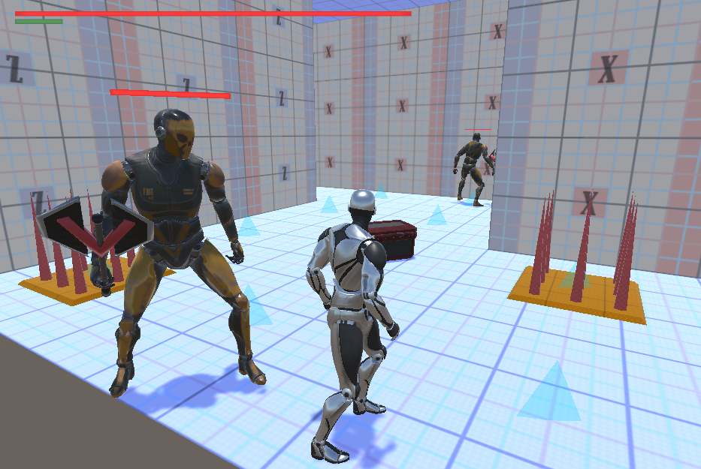
Research Goals
我們針對遊戲過程中的遊玩特徵 (gameplay patterns) 進行抽象化。
使用程序化生成技術產生帶有意義遊戲關卡內容，藉此消彌或降低因隨機性所產生的不穩定要素，以改善並豐富遊戲體驗。
 | Our Method | Dungeon Architect | DunGen
Build topology | PCG | Randomly PCG, Manually | Randomly PCG
Mission-based topology | Dynamic-nonlinear, meaningful structure | None | Stable-linear structure
Game Patterns | Genetic Algorithm | None | None
Our Method

Slide 6
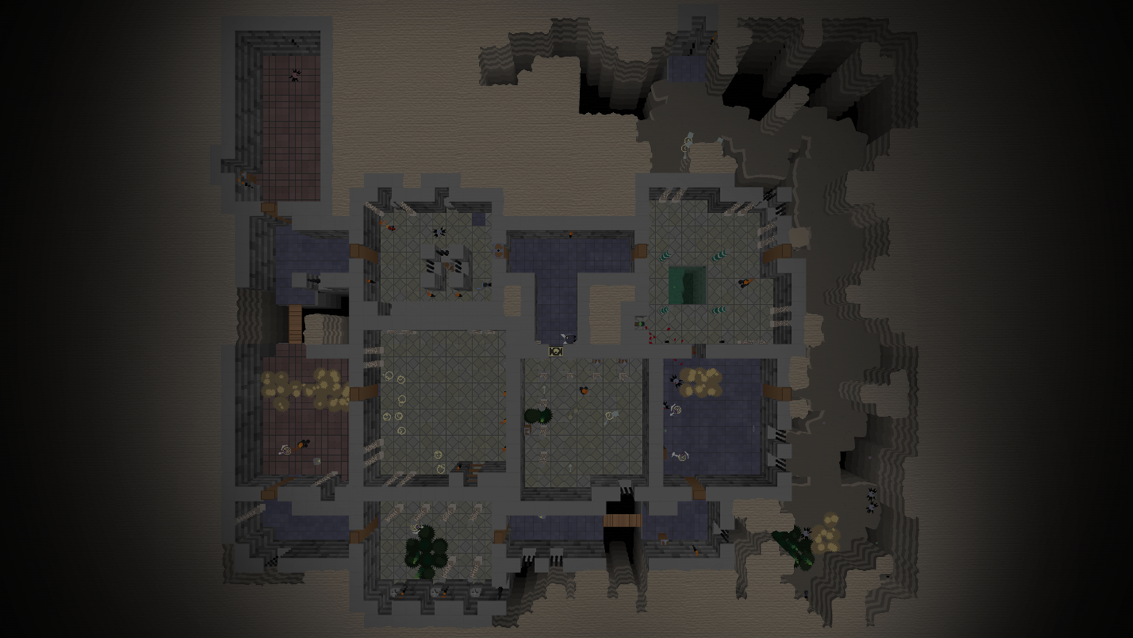
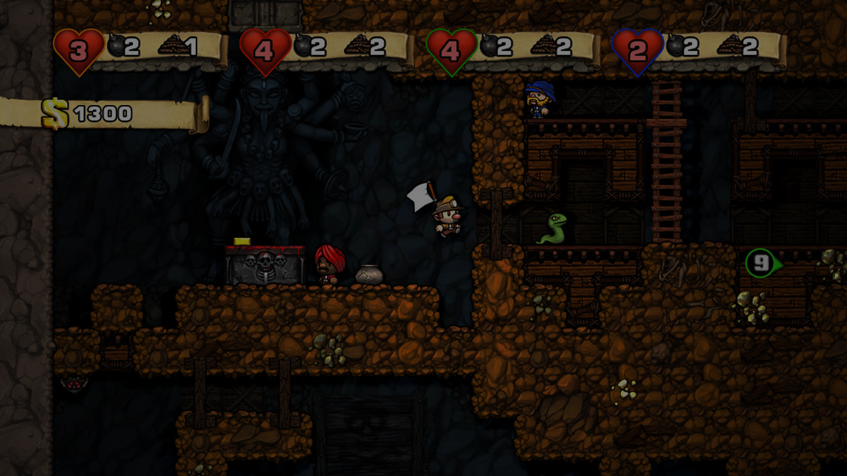
Related Works
Mission / Space framework
Map Sketches & Evolution of Segments

Slide 7
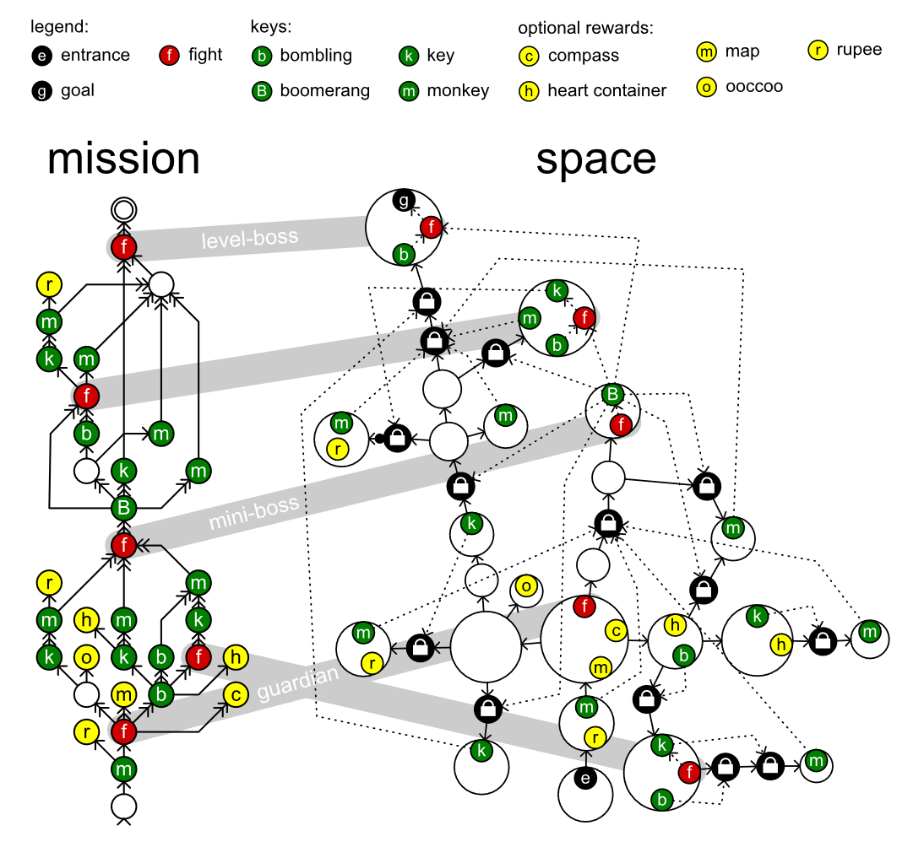
Mission / Space framework
Mission/Space framework, focuses on level design and the mechanics that control player progression through a game.
Transformational Grammars
Mission Grammars
Space Grammars
Mission Graph Convert into Space Graph

Slide 8
Transformational Grammars
Be consisted from an alphabet and a set of rules
Alphabet It is a set of symbols the grammar works with.
Set of rules It specifies what symbol can be replaced by what other symbols to form a new string.
Sides and symbols of the rule
Terminals (common in lowercase) Symbols in the alphabet can never be replaced because there are no rules.
Non-terminals (common in uppercase) Symbols have rules that specify their replacement.
S → ab
Symbol
Symbol
Symbol
{ S, a, b } is an alphabet

Slide 9

Mission Grammars
Inhibitions
Available when at least one of the weak prerequisites is completed.
Strong requirement
Available when all strong prerequisites are completed.
Weak requirement
Available when at least one of the weak prerequisites is completed.
Example of mission graph
Mission graphs represent the players’ progress towards a goal not by tracking their physical location, but by tracking the tasks they must perform to finish a level.
A mission graph is a directed graph that represents a sort of to-do list with each node representing a task that might or must be executed by the players.

Slide 10
Space Grammars
k
t
g
t
k
e

Slide 11
Mission Graph Convert into Space Graph
The steps in the generation progress investigated in this paper in detail:
An alternative method, does not go into detail:
Mission
Map
Space
Refine
Level
Create
Space
Distill
Mission
Adjust
Space
Refine
Level
Create

Slide 12
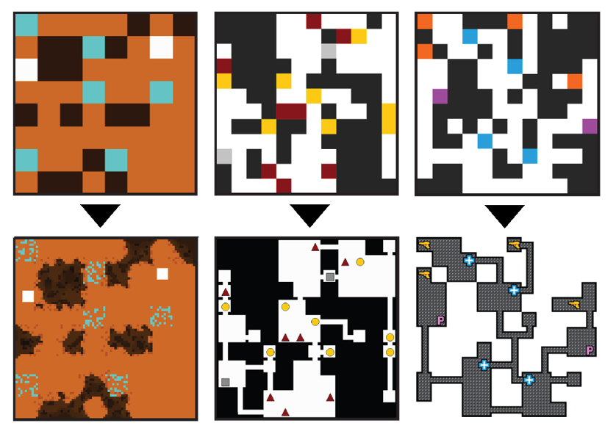
Map Sketches & Evolution of Segments
Under construction.
Map Sketches
Map Sketch Evolution
Dungeon Segments
Dungeon Segment Evolution

Slide 13
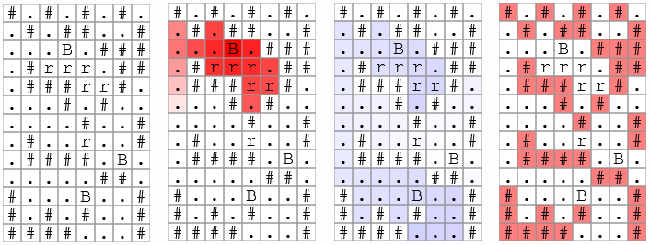

Map Sketches

Slide 14
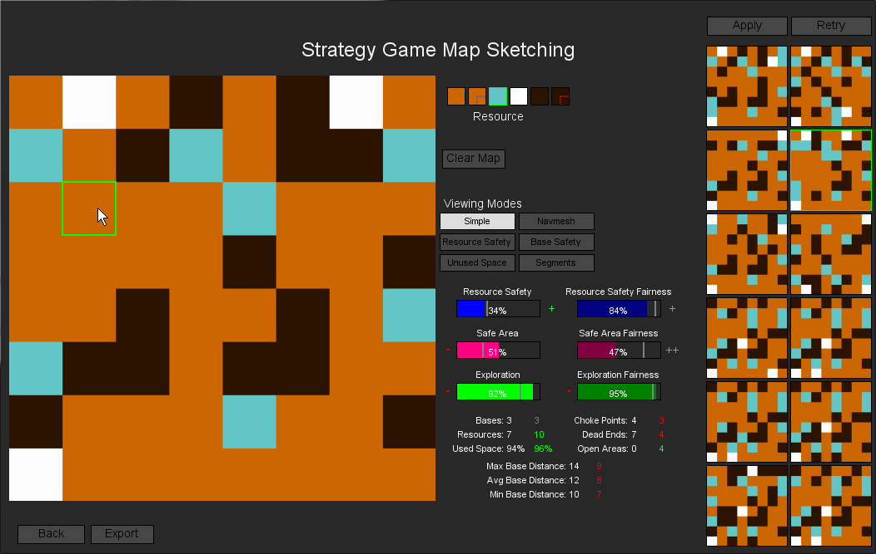
Map Sketch Evolution

Slide 15
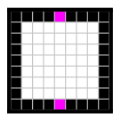
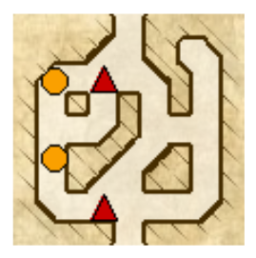
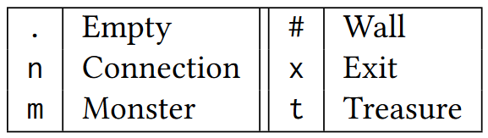
Dungeon Segments

Slide 16
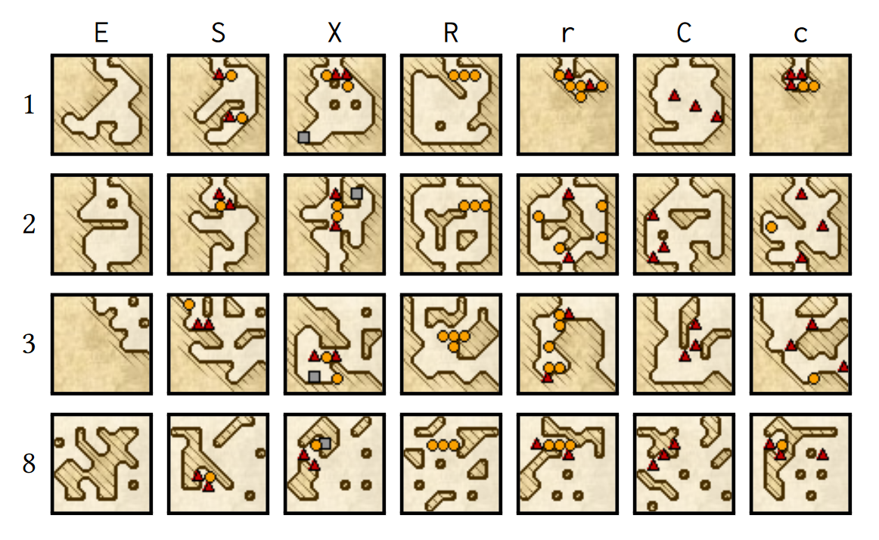
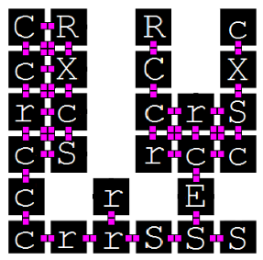
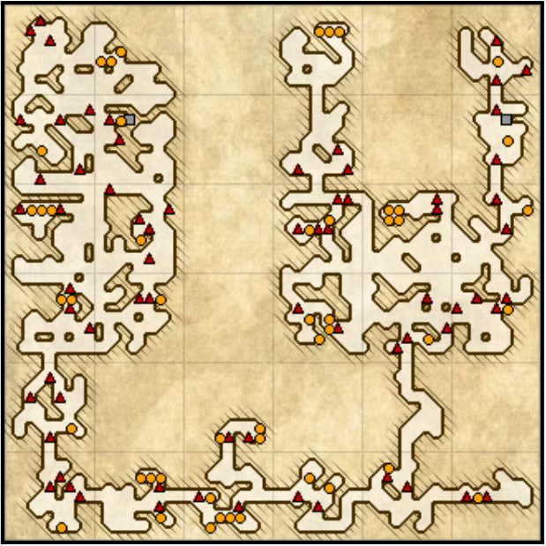
Dungeon Segment Evolution

Slide 17
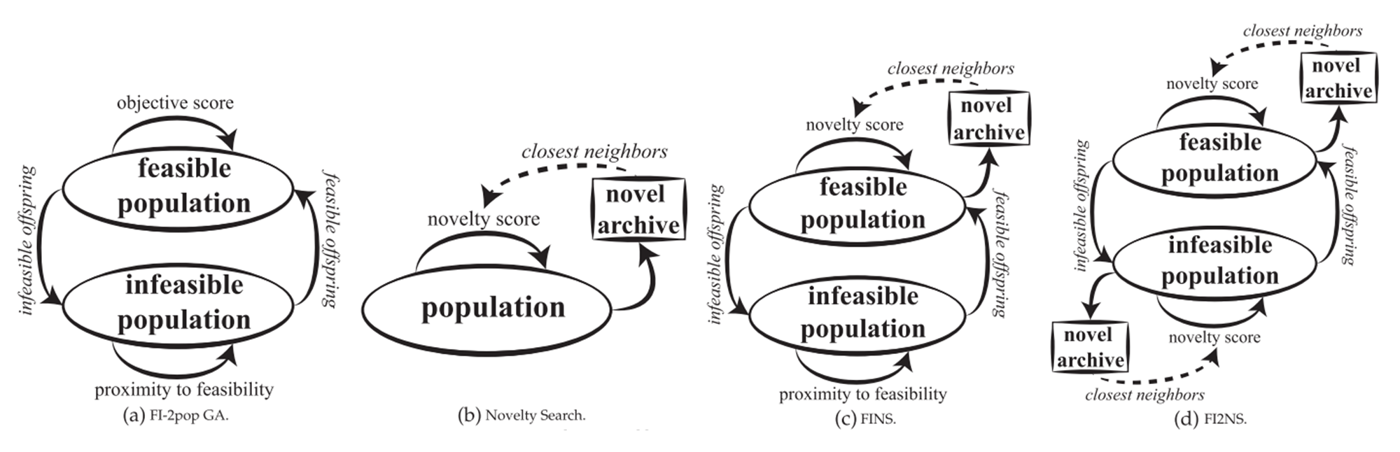
Constrained Novelty Search

Slide 18
Proposed Methodologies

Slide 19
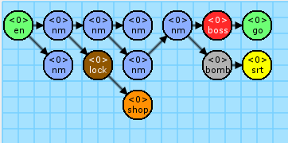
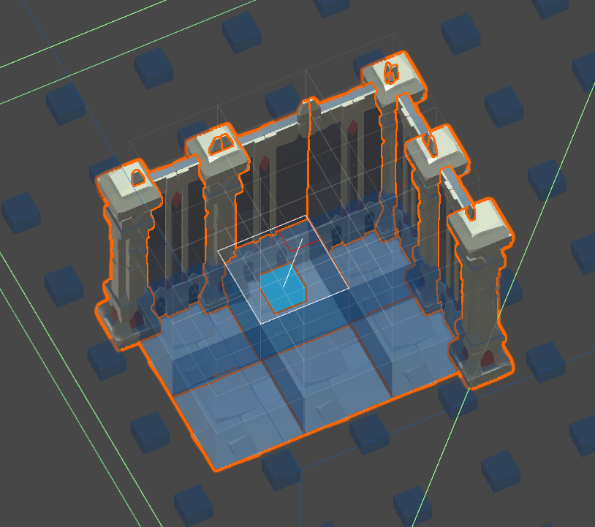
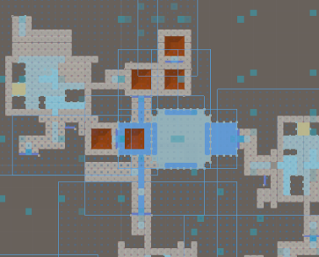
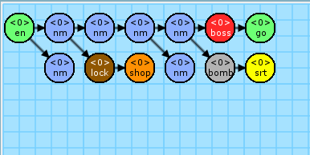
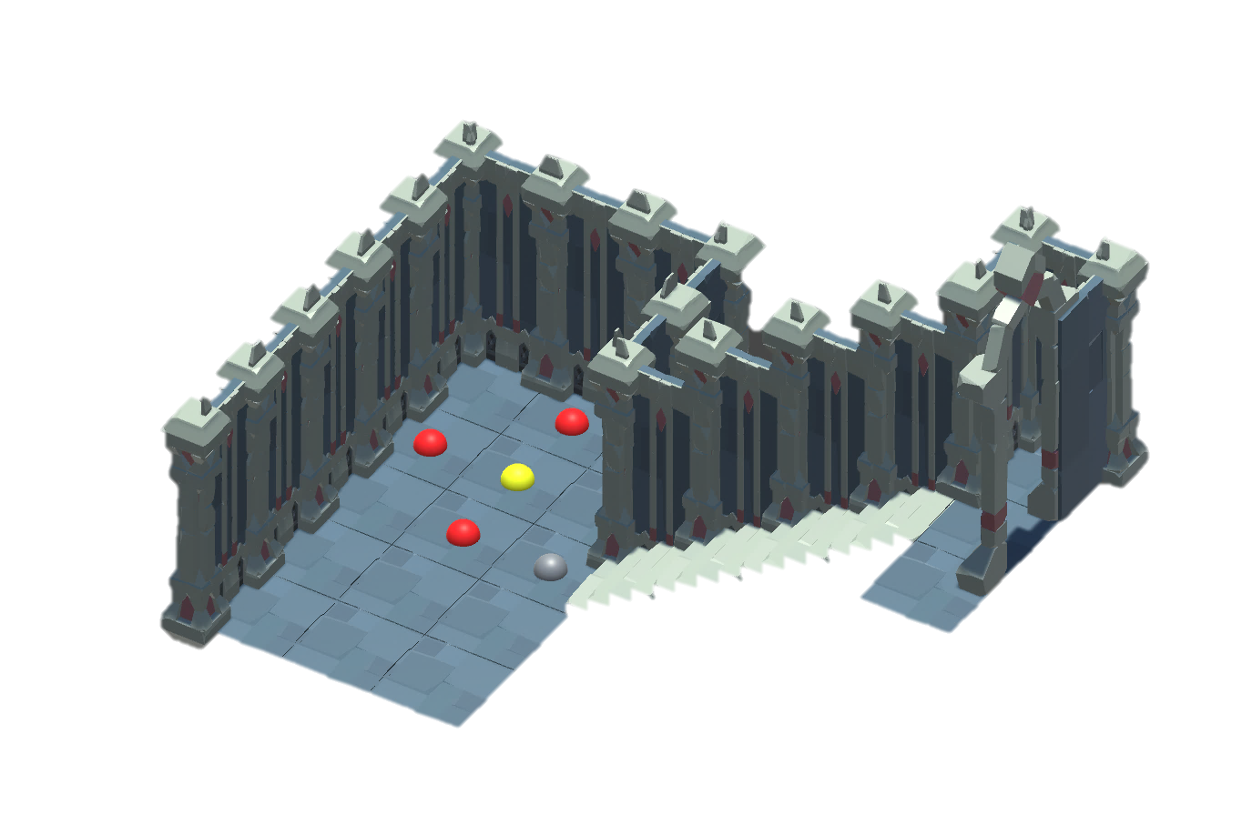
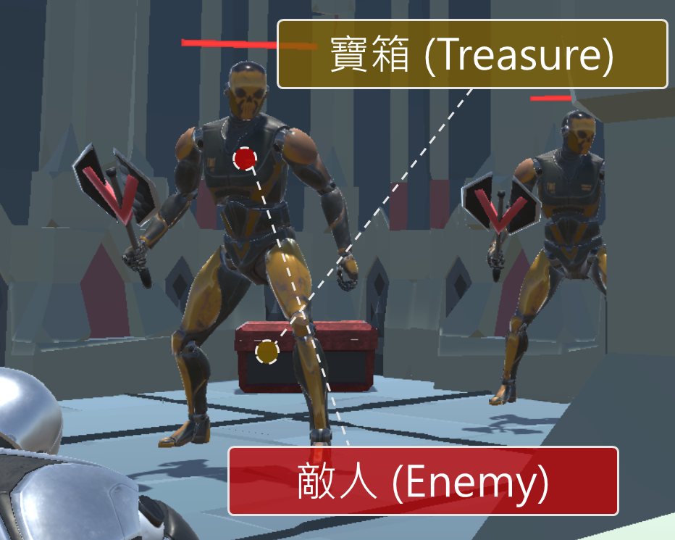
System Framework
Mission grammars
Build volumes
Generate the Space
Volume evolution
Completed level

Slide 20

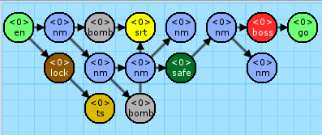
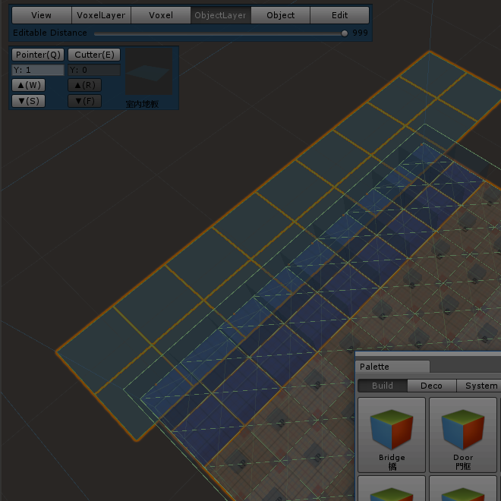
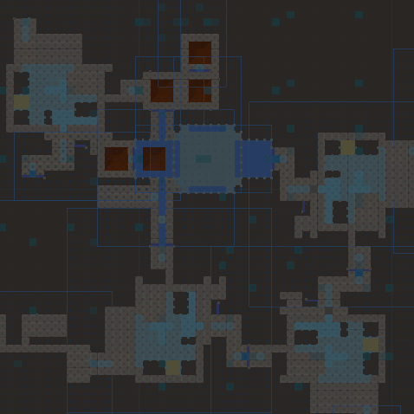
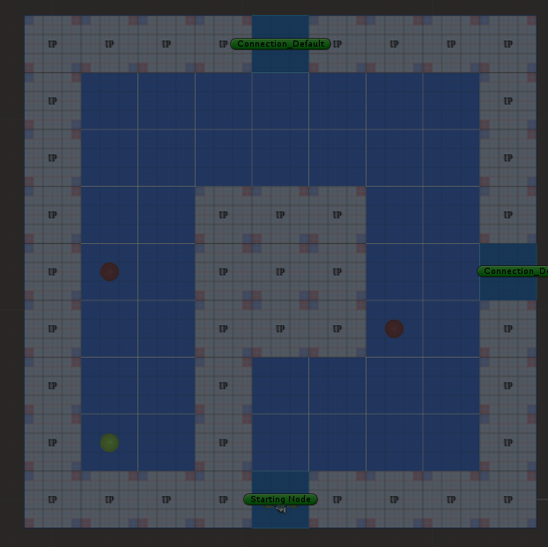
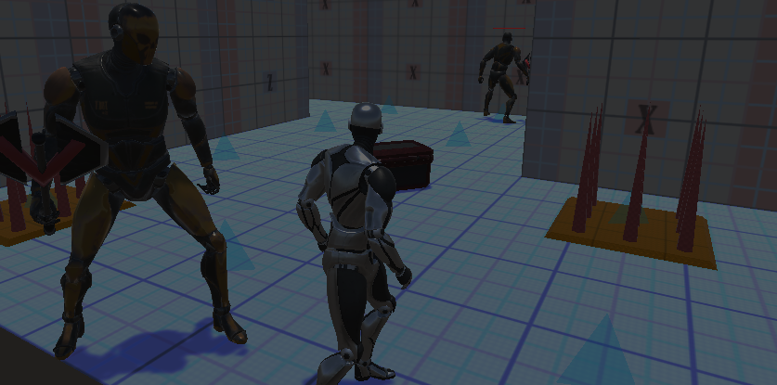
System Framework
1. Mission Grammars
Mission Alphabet
Mission Rules
Mission Graph
Rewrite System I
Random seed
Example of Mission Graph

Slide 21
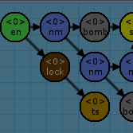

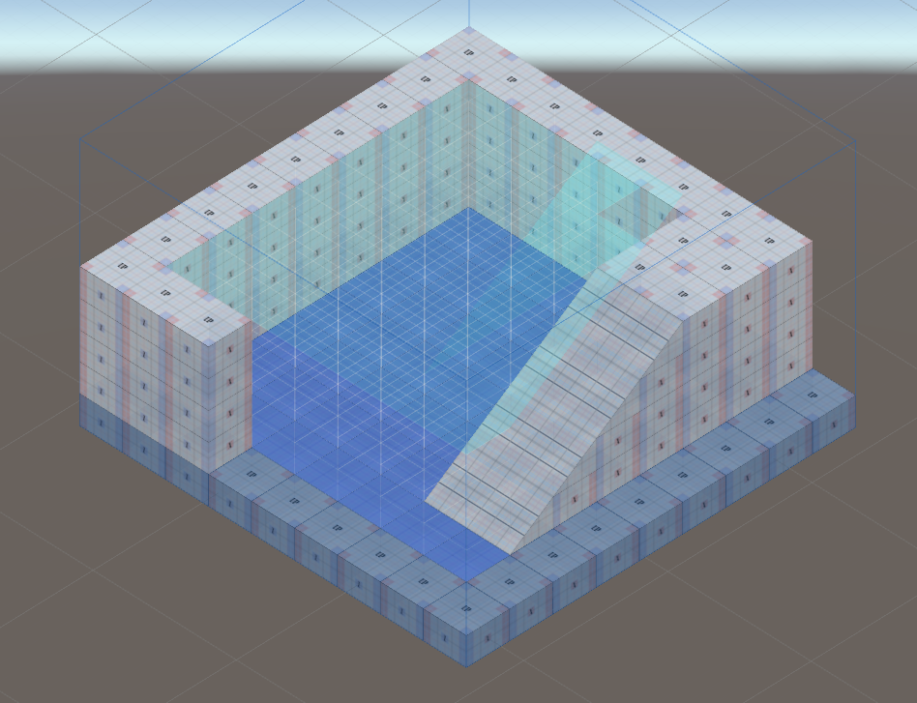
System Framework
2. Build Volumes
Voxel-based units
Decorations
Connections
Entrance
Exit
Example of volume

Slide 22
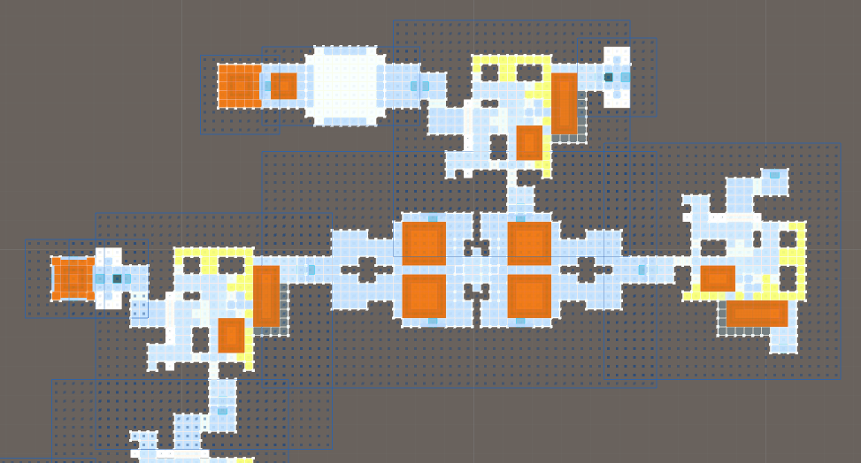

System Framework
3. Generate the Space
Rewrite System II
Instruction
Replacement
Collision issue
Example of space

Slide 23

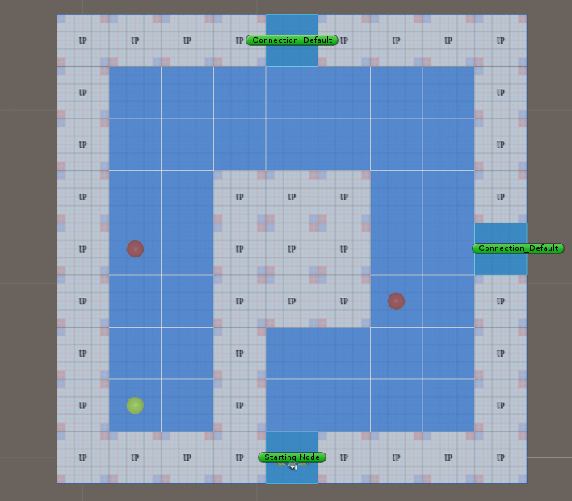
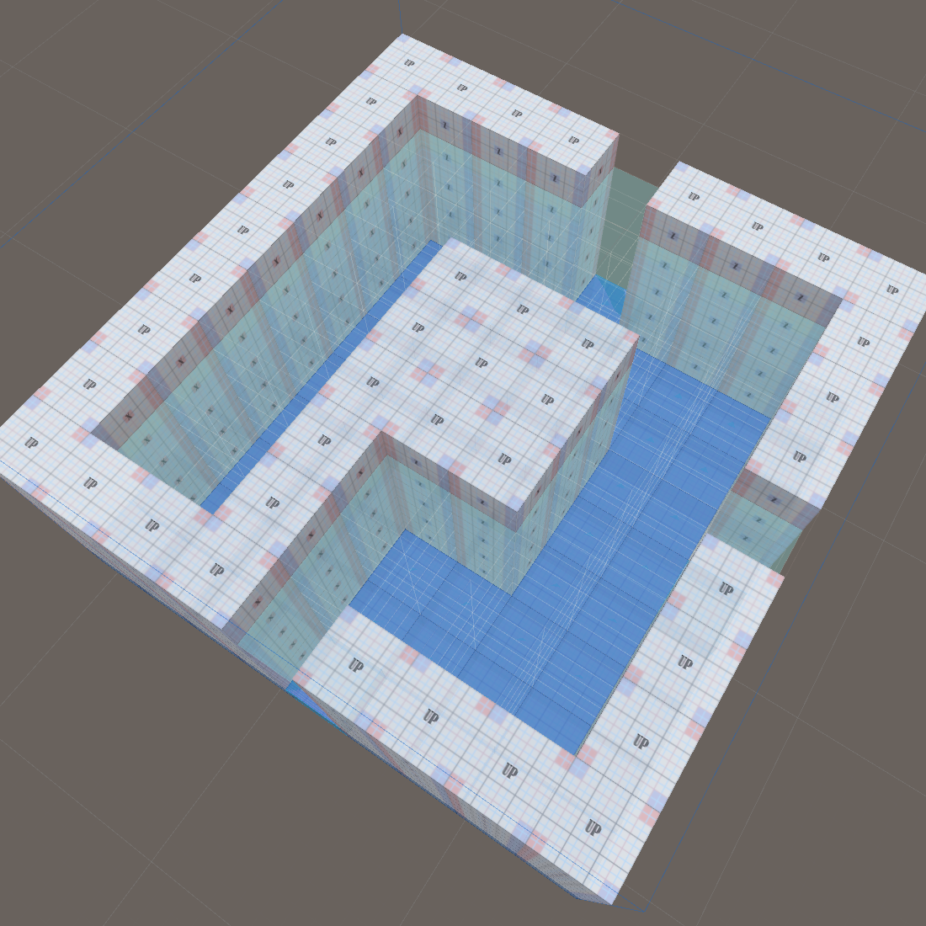

System Framework
4. Volume evolution (Generate the Gameplay Patterns)
Genetic Algorithm for emergence objects
Nine main metrics to design the fitness functions

Slide 24
System Framework

Slide 25
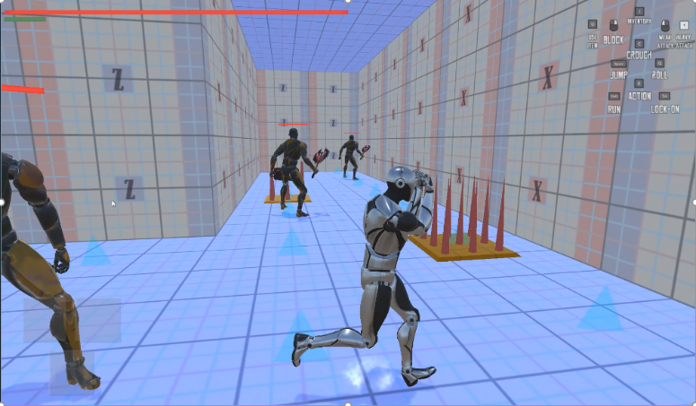
System DEMO
影片將會放置於此

Slide 26
Section 1. Mission Grammars
Export the mission graph

Slide 27
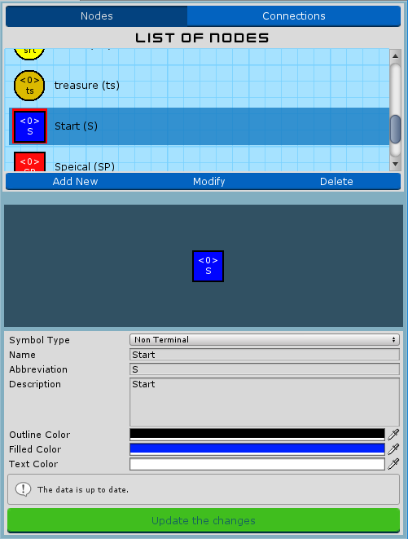
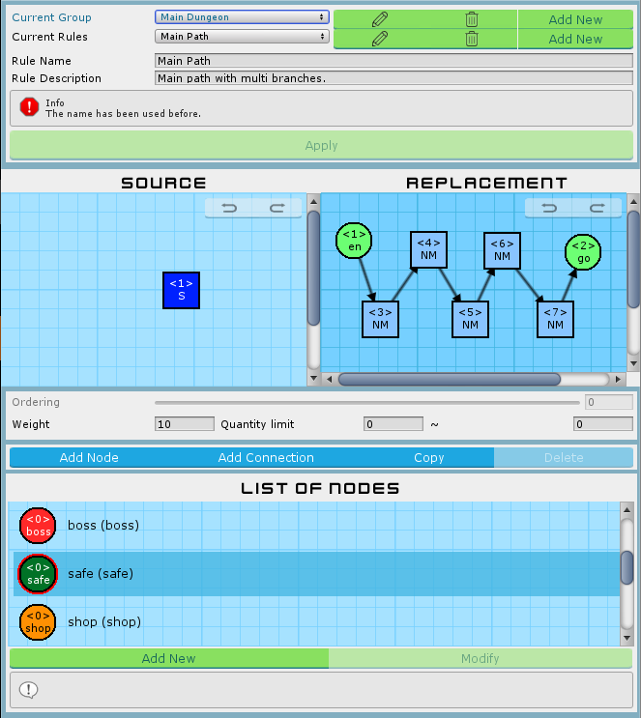
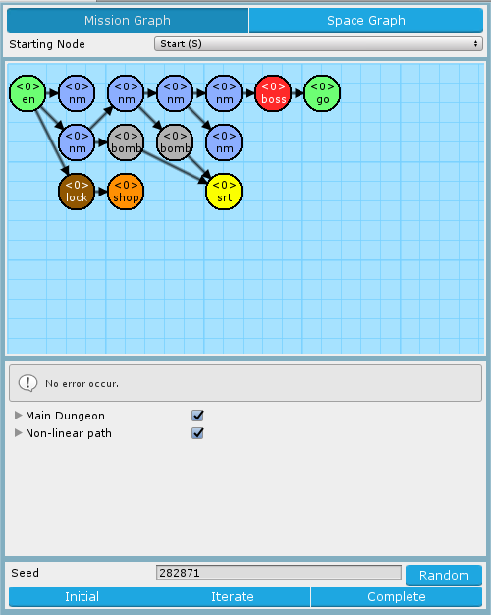


Mission Grammars
Mission Alphabet
Mission Rules
Mission Graph

Slide 28
Introduction of Mission Alphabet
List of symbols
Nodes and connections
Directly preview before selected
Preview area
Preview the symbol after editing immediately
Submit hint and form validations
Default and extended nodes
Default: Entrance, Goal
Extended: Any
Mission Alphabet Window

Slide 29
Introduction of Mission Rules
Hierarchy structure
Groups > Rules > Graph Grammar of Left-hand side & Right-hand side Rules
Friendly interface to create, delete and edit.
Rule canvas
Drag & drop to modify symbols
Custom size of canvas
Selected symbol highlighting
Connections stick on nodes automatically
Back trace the states (Redo / Undo)
Mission Rules Window

Slide 30
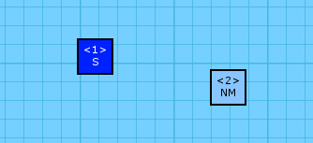
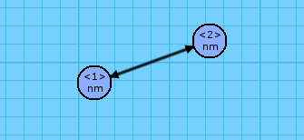
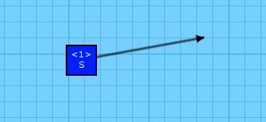
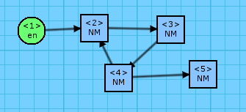
Avoid the illegal mission rules
Illegal rules will lead to the rewrite system generating fail or encounter the loop.
Isolated Node
Multiple Relations
And else ...
Isolated Connection
Cyclic Link

Slide 31
Set of illegal mission rules
Illegal pattern | Description
Left More Than Right | 當左側的節點超過右側的節點數量時，進行改寫系統會使左側無法對應到右側的節點產生遺失的情形。若這些節點原先已有與其它非規則內節點連接，將會導致該連接資訊遺失，有機會造成任務圖破碎。
Empty Left | 左側為空將無法進行子圖搜索，因此左側節點必須至少一個節點。
Isolated Node | 孤立的節點將會導致任務圖破碎。
Isolated Connection | 孤立的連接線無法正確表示其連接資訊，將無法正常進行改寫系統。
Exactly Duplicated | 若左右規則同構將導致改寫系統陷入無限循環。
Multiple Relations | 兩兩節點間不可有超過一個的連接關係，不論是同向連接線或反向連接線皆會導致改寫系統無法正常運作。
Cyclic Link | 任務圖的定義中，任務應嚴格遵守任務間之順序性，若有循環結構將會使玩家迂迴停滯。
Orphan Node | 若有圖形語法含有兩個以上的根結點，便無法正確定位出任務起點。
Overflowed Any Node | 當右側規則使用 Any 節點時，其對應到左側索引值的節點亦必須為 Any 節點。反之，左側規則使用 Any 節點將不在此限。

Slide 32
Introduction of Mission Graph
Set starting node
The head of the mission graph
Preview mission graph
Rewrite system I
Based on the selected rules in mission grammars
Find the matched subgraphs using rules
VF Graph Isomorphism Algorithm ^{[1]}
^{[1]} VF Graph Isomorphism Algorithm: | https://www.codeproject.com/Articles/23144/A-C-Implementation-of-the-VF-Graph-Isomorphism-Alg
Mission Graph Window

Slide 33
Rewrite System I
Find the matched rule from all rules
Randomly pick one if found many rules.
Current mission graph and left-hand side of rule are subgraph isomorphic.
Update the mission graph from the matched rule
Iterating until all nodes are replaced to terminal nodes.

Slide 34
Pseudocode of Rewrite System I
1 2 3 4 5 6 7 8 9 10 11 12 | Initialize random number generator via seed // Seed will affect the selection in FindMatchs Algorithm RewriteSystem1 (root, rules) matchedRule = FindMatchs(root, rules) // Transfer root into VF Graph if matchedRule is found from root and root doesn’t be explored: // If not found then skip RemoveConnections() // Remove the connections of matched parts with matchedRule ReplaceNodes() // Replace the nodes based on right-hand side AppendNodes() // Append the nodes that additional index in right-hand side ReAddConnections() // Re-add the connections based on right-hand side RevokeIndexes() // Revoke the index information of nodes in graph for child := root->children: // DFS RewriteSystem1(child, rules) return root

Slide 35
FindMatchs with the Random seed
1 2 3 4 5 6 7 8 | Function FindMatchs (VFGraph vfGraph) for rule := rules.shuffle(seed) // Random shuffle via random seed from random table if rule.QuantityLimitMax == 0: // If not found then skip continue if rule.leftHand is isomorphic to vfGraph: // Means the subgraph of vfGraph rule.QuantityLimitMax -= rule.QuantityLimitMax > 0 ? 1 : 0; return rule return root
Random table
Original “0” value has transferred to “-1” means the rule is unlimited usage

Slide 36
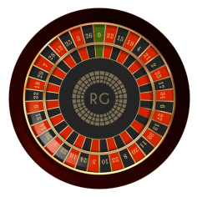
“FindMatchs” works
1:A
2:B
legal
1:A
2:D
illegal
A
B
…
c
1:A
2:c
legal
1:B
illegal
Current mission graph
Left-hand side of mission rules
1:A
2:B
…
2:B
2:B
4:B
roulette wheel selection
…
1:A
1:a
3:b
Current mission graph
Matched rule

Slide 37
“Rewrite System I” works
1:A
2:B
…
1:a
2:B
…
…
…
a
b
B
B
…
1. RemoveConnections
2. ReplaceNodes
…
…
…
5. RevokeIndexes (Final)
1:a
2:B
…
1:a
2:B
…
3:b
4:B
3:b
4:B
Matched rule
2:B
2:B
4:B
1:A
1:a
3:b
3. AppendNodes
4. ReAddConnections

Slide 38
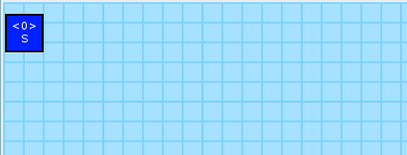
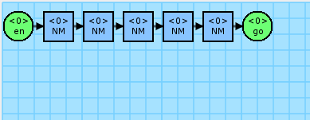
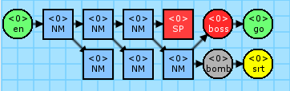
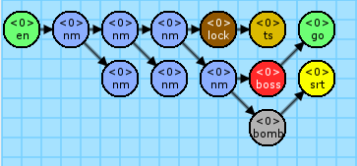
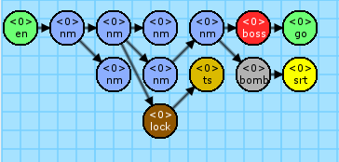
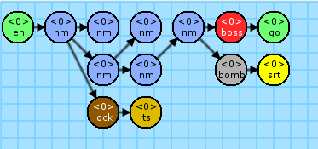
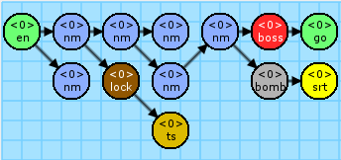
Perform iteration

Slide 39
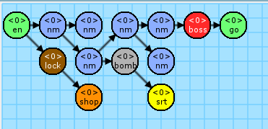

Example of Mission Graph
(a) Seed = 653543
(b) Seed = 246617
(c) Seed = 185606
(d) Seed = 183434

Slide 40












Manual
A
Create the Mission Alphabet
Node | Start | entrance | Normal | normal | boss | goal | Special | shop | bomb | lock | secret | treasure
 | (S) | (en) | (NM) | (nm) | (boss) | (go) | (SP) | (shop) | (bomb) | (lock) | (srt) | (ts)
Display
Require-ment |  |  |  |  | Battle and end |  | Multi -choice | Get the key from secret, then enter the secret or treasure room behind the wall that need to use the bomb to destroy it

Slide 41
















Manual
B
Design the Mission Rules
 | Left-hand | Right-hand
Main Path |  |  | Weight: | 10
 |  |  | Limit: | [0, ∞]
Boss Room |  |  | Weight: | 150
 |  |  | Limit: | [0, 1]
Set Secret |  |  | Weight: | 30
 |  |  | Limit: | [1, 1]
Expora-tion |  |  | Weight: | 10
 |  |  | Limit: | [0, ∞]
More Branch |  |  | Weight: | 20
 |  |  | Limit: | [0, 2]
 | Left-hand | Right-hand
Shop |  |  | Weight: | 10
 |  |  | Limit: | [0, 1]
Treasure |  |  | Weight: | 10
 |  |  | Limit: | [0, 1]
Forward Lock |  |  | Weight: | 10
 |  |  | Limit: | [0, 2]
Flat Rooms |  |  | Weight: | 10
 |  |  | Limit: | [0, ∞]

Slide 42
Manual
C
Export the Mission Graph
Set the starting node
Start to execute the iteration from the root.
Set the random seed (Random number table)
Seed affects selection when there are many candidates, or and the additional iterations ^{[1]} in the moment.
^{[1]} additional iterations: | The completed generation means all nodes in the graph are replaced to terminal nodes. Additionally executes more iterations to parallel rewrite the current graph.

Slide 43
Section 2. Build Volumes
Build the volumes of level

Slide 44
Build Volumes
Editor
Voxel-based units
Markers I - Decorations
Markers II - Connections

Slide 45


Voxel-based units in Editor
Hierarchy data structure
Level A set of volumes. Expresses a complete game level.
Volume A set of chunks. Mostly expresses a room.
Chunk Consists of 9x9x9 voxel. Based on the size of volume, uses different numbers of chunk.
Voxel The minimum unit of level, size is 3x2x3. It’s property is a decoration with nine orientations.
Floors
Walls
Pillars

Slide 46




Decorations in Editor
Floor
Stair
Wall
Pillar
Door

Slide 47

Connections in Editor
Volume A
Entrance
Zero or one
Inner direction
Exit
Any amount
Outer direction
Volume B
The exits of “volume A” will stick with the entrance of “volume B”, according to their direction of arrow. If doesn’t exist any entrance, will pick one exit randomly.

Slide 48

Manual
D
Design the Volumes
Must prepare the volumes to map the mission alphabet

Slide 49

Manual
E
Append the Entrance & Exit
Append the connection marker with direction
Binding will based on their y-axis layer
Stochastic one exit will be an entrance if don't exist entrance marker in the volume

Slide 50
Section 3. Generate the Space
Mission graph transforms into level space

Slide 51


Rewrite System II
Rewrite System II
Instruction
Replacement
Pseudocode
Based on the mission graph, transform it into space

Slide 52
Instruction of Rewrite System II
Space rules (simplify, expressed in 2D)
Mission graph
Space graph
C
Rule | build entrance
Inst. | en (entrance)
Rep. | Entance
Rule | grow section 2
Inst. | x (explore)
Rep. | Connection
W
C
1:en
2:x
3:go
C
C
C
W
C
C
W
W
C
Rule | grow section 1
Inst. | x (explore)
Rep. | Connection
Rule | goal
Inst. | go (goal)
Rep. | Connection
W
C
W
C
Each rule in the shape grammar was associated with a terminal symbol in the mission grammar.
Look for rules that implement that symbol, selects one at random based on their relative weight.

Slide 53
Replacement of Rewrite System II
Space rules (simplify, expressed in 2D)
Space graph
C
Rule | build entrance
Inst. | en (entrance)
Rep. | Entance
Rule | grow section 2
Inst. | x (explore)
Rep. | Connection
W
C
C
C
W
C
W
C
Rule | grow section 1
Inst. | x (explore)
Rep. | Connection
Rule | goal
Inst. | go (goal)
Rep. | Connection
W
C
Rule | close connection
Inst. | (none)
Rep. | Connection
wa
W
Rule | protowall2
Inst. | (none)
Rep. | ProtoWall
After all nodes in mission graph having transferred into space, the remaining connections have to fit the completed space.
Rule | protowall1
Inst. | (none)
Rep. | ProtoWall
W
wa

Slide 54
Pseudocode of Rewrite System II
1 2 3 4 5 6 7 8 9 10 11 12 13 14 15 16 17 18 19 20

Slide 55


“Rewrite System II” works

Slide 56

Manual
F
Defined the Instruction of Rewrite System
List of the terminal symbols from Mission Grammars.
Elements in list, they have own volume list.

Slide 57
Manual
G
Defined the Replacement of Rewrite System

Slide 58
Section 4. Volume Evolution
Generate the game objects in volumes to express gameplay patterns

Slide 59
Genetic Algorithm in Segments Evolution
Genetic Algorithm
Algorithm flow
Gene
Crossover
Mutation
Fitness functions of GA
Common parts
Metrics

Slide 60














Algorithm flow
1
2
3
4
spring
parents
+2.0
-0.8
+0.2
+1.5
springs
mutation
Initial population
Calculate fitness scores
Mutation
Crossover
5
previous
6
7
if fitness > threshold
then go to
else
then go to
=
2
evolution
7
Generation
Termination condition
Export the best individual

Slide 61



Gene and individual
Chromosome of individual = [
Empty
]
Enemy
4
3
9
8
14
21
Treasure
2
13
18
1
7
16
17
20
6
12
15
19
Trap
Gene = {
position: (x, y, z), type:
}
0
11
5
10

Slide 62
Crossover
2 point
Parents
Offspring
80% crossover
Two point crossover

Slide 63
Mutation
Parents
Offspring
10% mutation
Change 5% ~ 20% positions each chromosome

Slide 64
Fitness functions of GA
Common parts
Main Path Calculation
Normalize the fitness scores
Metrics
Guard
Block
Patrol

Slide 65


Main Path Calculation using A-Star
Ex
1
1
1
Ex
2
2
1
1
1
1
1
Ex
Ex
1
1
1
1
1
Ex
1
1
1
1
1
3
1
3
Ex
En

Slide 66




Metric: Guard
Fitness function:
$$f_{grd}=\sum_{i=1}^{M}{e_{i}}$$
 | Enemy
 | Treasure
Example gameplay of “Guard”

Slide 67




Metric: Block
Fitness function:
 | Enemy
 | Treasure
 | Trap
$$f_{blk}=\sum_{i=1}^{M}{e_{i}}$$
Example gameplay of “Block”

Slide 68

Metric: Patrol
Fitness function:
 | Enemy
 | Treasure
 | Trap
$$f_{blk}=\sum_{i=1}^{M}{e_{i}}$$
Example gameplay of “Patrol”

Slide 69

Balance fitness function
Fitness function:
$$f_{dst}=\left\{\begin{aligned}1, N ≤O ≤M \\ 0, if O<N or O>N\end{aligned}\right.$$

Slide 70





Normalize the fitness scores
Parameters
An example. If $N$ = 10
$f_{1}\left(0\right)=0.$0000 ; $f_{2}\left(0\right)=0.0000$
$f_{1}\left(1\right)≅0.1000$ ; $f_{2}\left(1\right)=0.3162$
$f_{1}\left(2\right)≅0.2000$ ; $f_{2}\left(2\right)=0.\text{4472}$
$f_{1}\left(3\right)≅0.3000$ ; $f_{2}\left(3\right)=0.5477$
$x$ : | Un-normalized score
$N$ : | Maximum of un-normalized score
$f\left(x\right)$ : | Normalized score
+ 0.1000
+ 0.3162
+ 0.1000
+ 0.1310
$f_{1}\left(x\right)$ is the original normalization
$f_{2}\left(x\right)$ is we expected normalization
+ 0.1000
$$+ \text{0.1005}$$

Slide 71

Manual
H
Set the weights of fitness functions
Setting about fitness function weights of each volume
Same volumes can be duplicated used on different positions

Slide 72
Manual
I
Export the completed level

Slide 73
Experimental Results

Slide 74
Experiment design

Slide 76
Data Collection
Run no. | Gen. no. | Chm. no. | label | score | position | type | volume
• • •
1 | 10 | 3 | Block | 0 | (12.0, 1.0, 0.0) | Enemy | Room A
1 | 10 | 3 | Intercept | 0 | (12.0, 1.0, 0.0) | Enemy | Room A
1 | 10 | 3 | Patrol | 0.35 | (12.0, 1.0, 0.0) | Enemy | Room A
1 | 10 | 3 | Guard | 0.85 | (12.0, 1.0, 0.0) | Enemy | Room A
• • •
Raw data:

Slide 77
Data Filtering of Fitness Comparison
Run no. | Gen. no. | Chm. no. | label | score | position | type | volume
• • •
1 | 10 | 3 | Block | 0.35 | (12.0, 1.0, 0.0) | Enemy | Room A
1 | 10 | 3 | Intercept | 0.85 | (12.0, 1.0, 0.0) | Enemy | Room A
1 | 10 | 3 | Block | 0 | (12.0, 2.0, 0.0) | Empty | Room A
1 | 10 | 3 | Intercept | 0 | (12.0, 2.0, 0.0) | Empty | Room A
• • •
Calculate the sum of the fitness score each chromosome.
1 2 | // Remove useless columns. data.drop(['position', 'type']) // Remove duplicated rows. data.drop_duplicates([''])

Slide 78

Fitness Comparison

Slide 79
Data Filtering of Density Analysis
Run no. | Gen. no. | Chm. no. | label | score | position | type | volume
• • •
1 | 10 | 3 | Block | 0 | (12.0, 1.0, 0.0) | Enemy | Room A
1 | 10 | 3 | Intercept | 0 | (12.0, 1.0, 0.0) | Enemy | Room A
1 | 10 | 3 | Patrol | 0.35 | (12.0, 1.0, 0.0) | Enemy | Room A
1 | 10 | 3 | Guard | 0.85 | (12.0, 1.0, 0.0) | Enemy | Room A
• • •
Useless and duplicated
Store the positions and their gene types each chromosome (individual).
1 2 | // Remove useless columns. data.drop(['label', 'score']) // Remove duplicated rows. data.drop_duplicates(['Run no.', 'Gen no.', 'chm no.', 'position'])

Slide 80





Density Analysis

Slide 81





Density Analysis

Slide 82
Conclusions and Contributions

Slide 83
Conclusions

Slide 84
Contributions
Provide a systematic framework to make game designers develop the game level rapidly.
Mission-driven topology.
Tool about procedural content generation for mission graph.
Multi-objective problem in GA

Slide 85

Future Work

Slide 86


Pacing-based Level Generation

Slide 87

References
Dormans, J. (2010, June). Adventures in level design: generating missions and spaces for action adventure games. In Proceedings of the 2010 workshop on procedural content generation in games (p. 1). ACM.
Dormans, J. (2011, June). Level design as model transformation: a strategy for automated content generation. In Proceedings of the 2nd International Workshop on Procedural Content Generation in Games (p. 2). ACM.
Dormans, J. (2012, May). Generating Emergent Physics for Action-Adventure Games. In PCG@ FDG (pp. 9-1).
Karavolos, D., Liapis, A., & Yannakakis, G. N. (2016, September). Evolving missions to create game spaces. In Computational Intelligence and Games (CIG), 2016 IEEE Conference on (pp. 1-8). IEEE.
Liapis, A. (2017). Multi-segment Evolution of Dungeon Game Levels.
Karavolos, D., Bouwer, A., & Bidarra, R. (2015). Mixed-Initiative Design of Game Levels: Integrating Mission and Space into Level Generation. In FDG.
Liapis, A., Yannakakis, G. N., & Togelius, J. (2015). Constrained novelty search: A study on game content generation. Evolutionary computation, 23(1), 101-129.
Liapis, A., Yannakakis, G. N., & Togelius, J. (2013, April). Generating map sketches for strategy games. In European Conference on the Applications of Evolutionary Computation (pp. 264-273). Springer Berlin Heidelberg.
Font, J. M., Izquierdo, R., Manrique, D., & Togelius, J. (2016, March). Constrained Level Generation Through Grammar-Based Evolutionary Algorithms. In European Conference on the Applications of Evolutionary Computation (pp. 558-573). Springer International Publishing
Lanzi, P. L., Loiacono, D., & Stucchi, R. (2014, August). Evolving maps for match balancing in first person shooters. In Computational Intelligence and Games (CIG), 2014 IEEE Conference on (pp. 1-8). IEEE.
Zook, A., & Riedl, M. O. (2014, July). Automatic Game Design via Mechanic Generation. In AAAI (pp. 530-537).
Dormans, J. (2012). Engineering emergence: applied theory for game design. Creative Commons.
Neil, K. (2015). Game Design Tools: Can They Improve Game Design Practice? (Doctoral dissertation, Conservatoire national des arts et metiers-CNAM).

